Slide 1
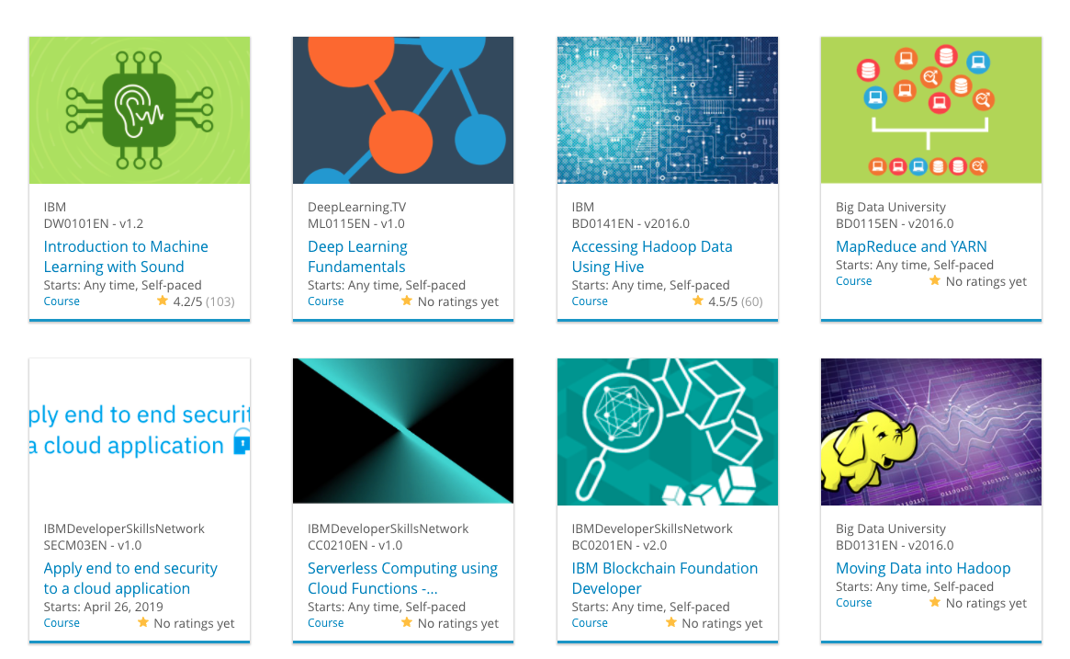

Build a Personalized Online Course Recommender System with Machine Learning
Dhanush V. Hegde
08-10-2026

Slide 2

Outline
Introduction and Background
Exploratory Data Analysis
Content-based Recommender System using Unsupervised Learning
Collaborative-filtering based Recommender System using Supervised learning
Conclusion
Appendix

Slide 3
Introduction
Project Background and Context
Online learning platforms offer a large number of courses across different learning areas.
Learners may find it difficult to identify courses that match their interests and previous learning behavior.
A machine learning-based recommendation system can help learners discover relevant courses.
This project develops and compares multiple recommendation approaches using course information and learner-course interactions.
Hypotheses
H1: Course content and genre information can be used to generate relevant course recommendations.
H2: Learner interaction history can improve personalized recommendations through collaborative filtering.
H3: Combining different recommendation approaches can provide a more effective recommendation strategy.

Slide 4
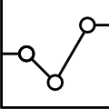
Exploratory Data Analysis

Slide 5
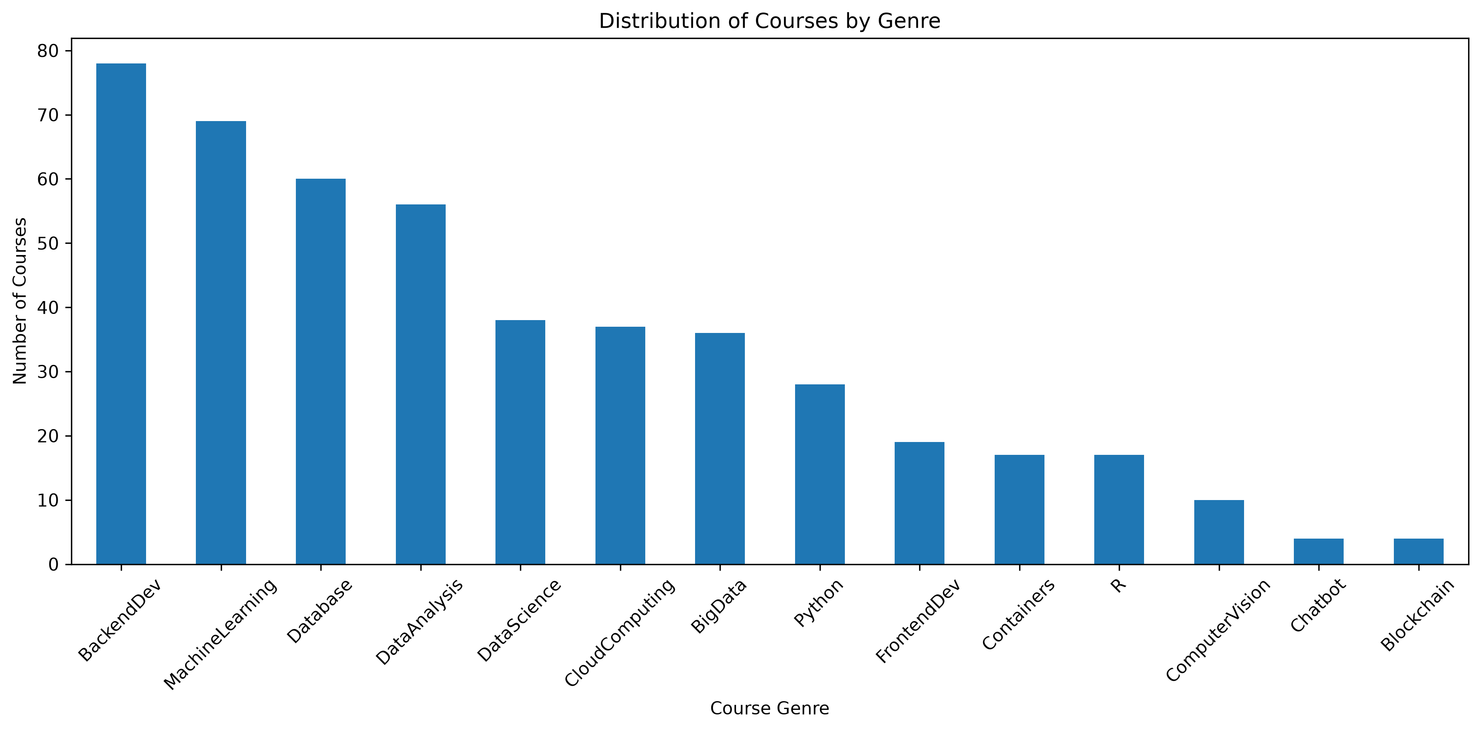
Course counts per genre
The chart shows the distribution of courses across the different course genres. It highlights which learning areas have the largest representation in the course catalog and which genres have fewer courses.

Slide 6
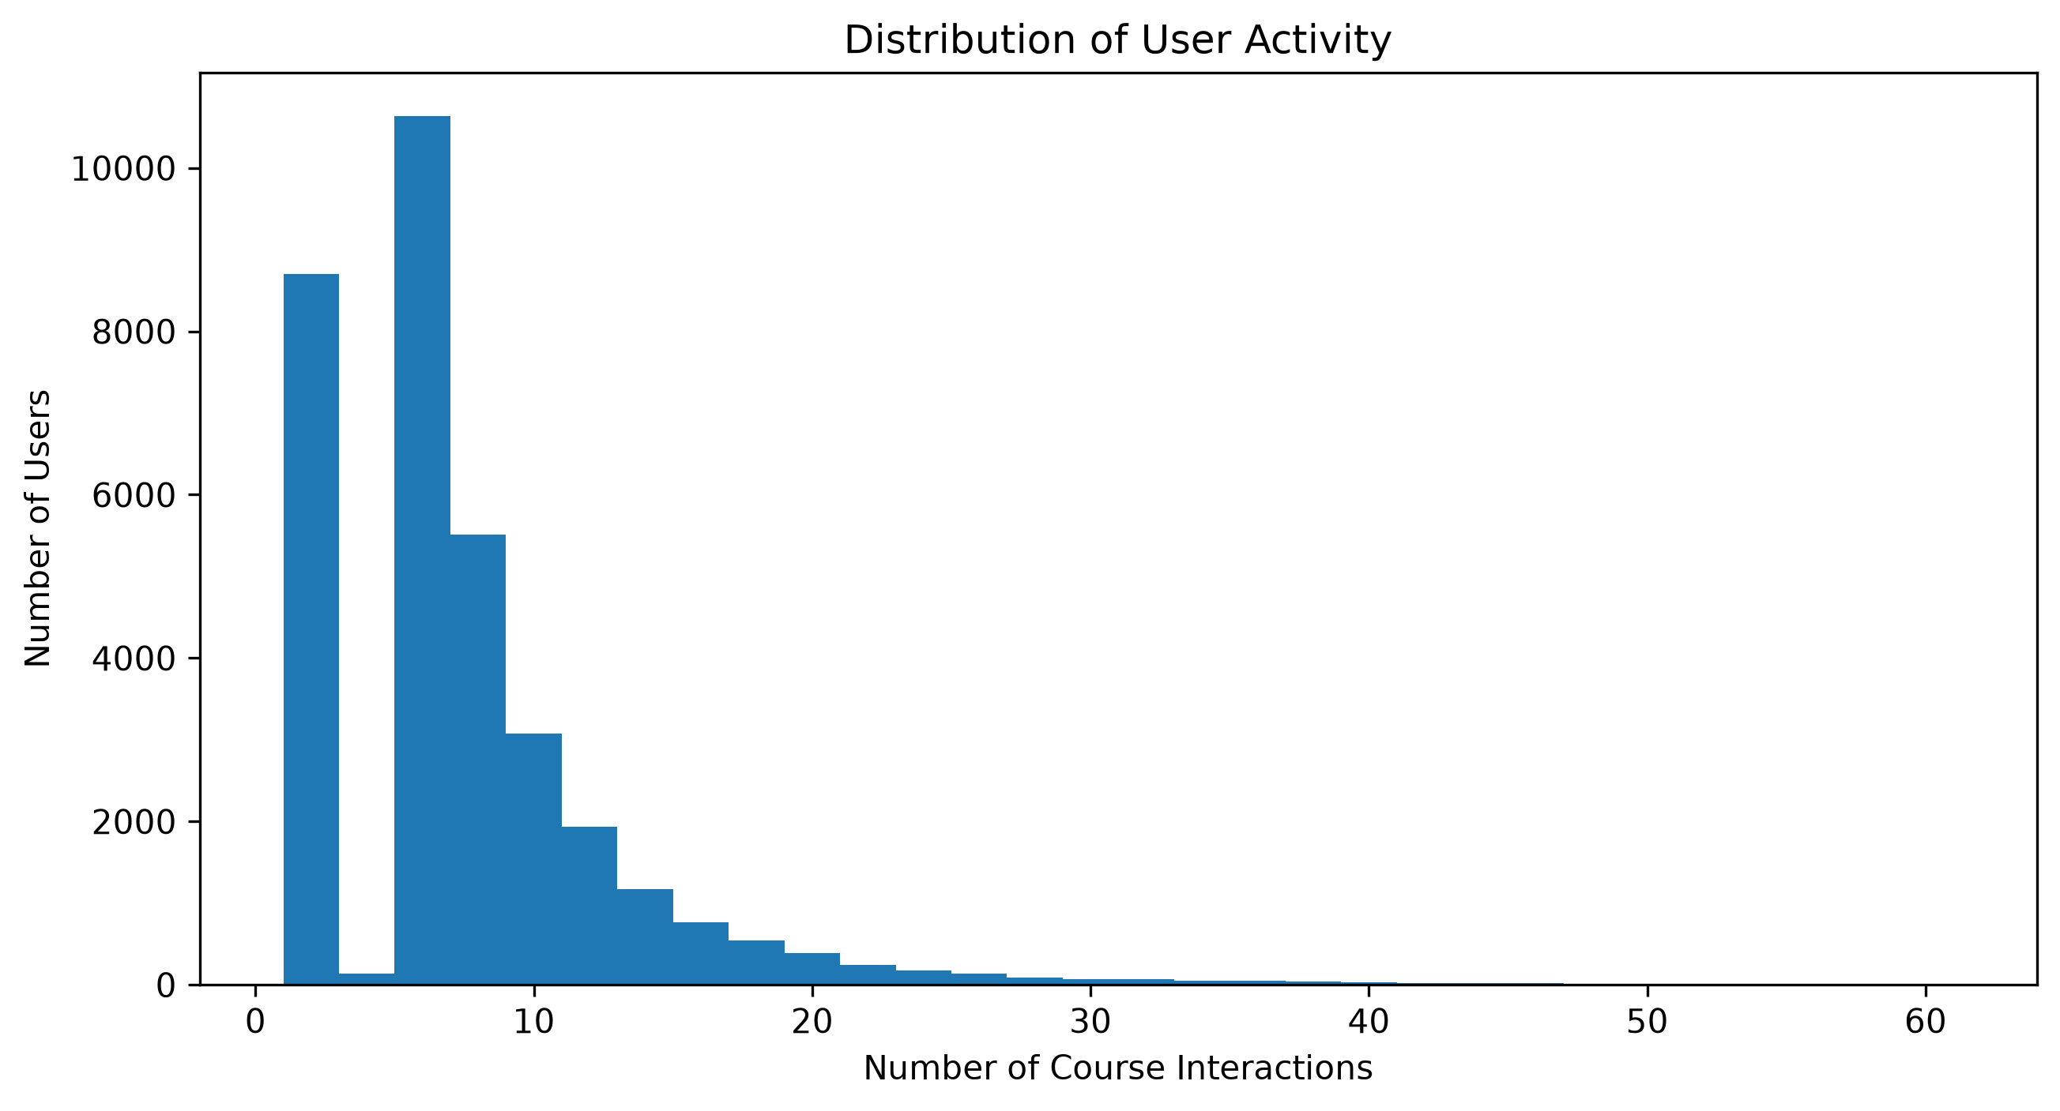
Course enrollment distribution
The histogram shows the distribution of course interactions across learners. It helps identify how frequently learners interact with courses and whether the dataset contains mostly low-activity or highly active learners.
- A sample histogram may look like the following:

Slide 7
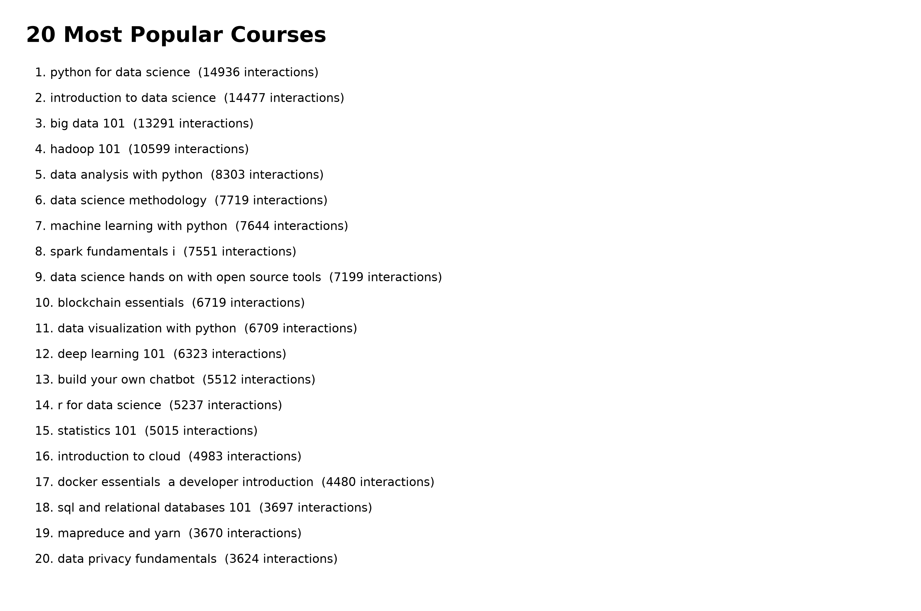
20 most popular courses
The chart shows the 20 courses with the highest number of learner interactions. It highlights the most popular courses in the dataset based on learner activity.

Slide 8
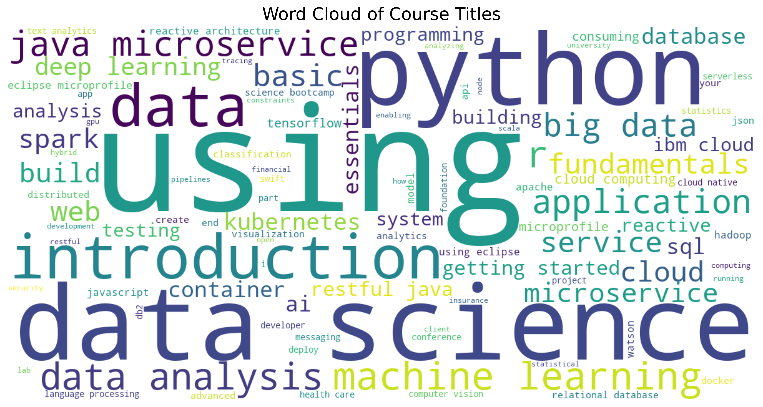
Word cloud of course titles
Explanation: The word cloud summarizes the main terms appearing in the course titles. Larger words represent terms that occur more frequently, helping us identify the major subject areas and topics represented in the course catalog. This analysis also provides an initial understanding of the textual information that can later be used for content-based recommendation.

Slide 9
Content-based Recommender System using Unsupervised Learning
Cluster2
Cluster1

Slide 10
Flowchart of content-based recommender system using user profile and course genres
Users + Courses + Interactions
Users + Courses + Interactions
Users + Courses + Interactions
The system combines learner interaction history with course genre information to create user profile vectors. Course genre vectors are then compared with the learner profile using cosine similarity. Courses with the highest similarity scores are ranked and recommended to the learner.
Raw Dataset
Cleaning and Preprocessing
Cleaned datasets
Course Generation Features
User Profile+ Course Genre

Slide 11
Evaluation results of user profile-based recommender system
Hyper-parameters
Number of recommendations: 10
Similarity measure: Cosine Similarity
Test users: 50
On average, how many new/unseen courses have been recommended per user (in the test user dataset)
Average unseen courses per user: 8.34
getting started with the data apache spark makers build (27)
foundations for big data analysis with sql (27)
analyzing big data with sql (27)
spark overview for scala analytics (27)
spark fundamentals ii (27)
spark fundamentals i (27)
analyzing big data in r using apache spark (19)
accessing hadoop data using hive (19)
using hbase for real time access to your big data (16)
big data capstone project (13)

Slide 12
Flowchart of content-based recommender system using course similarity
The course similarity recommender uses cleaned course text to create TF-IDF feature vectors. Cosine similarity is then used to compare courses and identify the most similar courses for recommendation.
Course titles + descriptions
Text preprocessing + TF-IDF
Cleaned course titles and descriptions
TF-IDF course vectors
Course feature representation

Slide 13
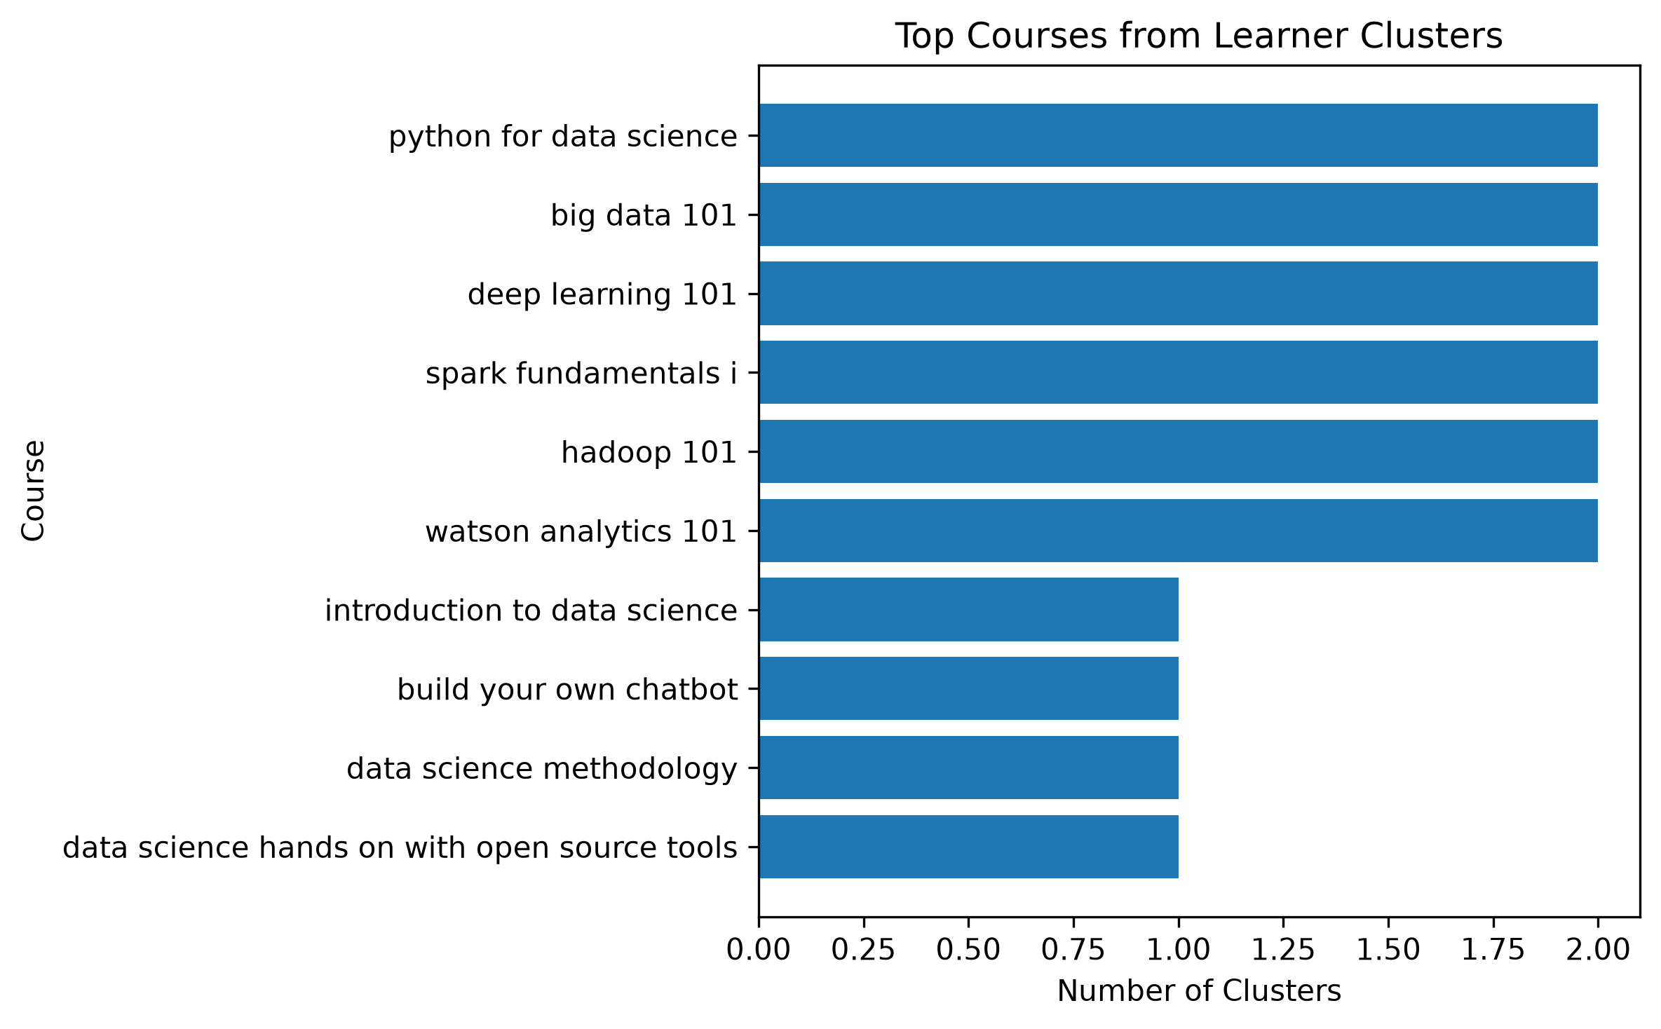
Evaluation results of course similarity based recommender system
Similarity method: Cosine Similarity
Number of recommendations: 5
Similarity method: Cosine similarity
Text representation: TF-IDF
Maximum TF-IDF Features: 1000
On average, how many new/unseen courses have been recommended per user (in the test user dataset)
Average recommended courses per course: 5.8

Slide 14
Flowchart of clustering-based recommender system
Learner interaction data is processed to create user profiles based on course genre preferences. These profile vectors are then used as features for K-Means clustering to group learners with similar interests. The resulting learner groups can be used to identify courses that are relevant to each cluster.
User-course interactions
Create user genre profiles
Cleaned user profiles + course data
Genre preference vectors
User profile feature matrix

Slide 15
Evaluation results of clustering-based recommender system
Algorithm: K-Means
Number of clusters: 3
Evaluation Samples: 300 users
Random state:42
On average, how many new/unseen courses have been recommended per user (in the test user dataset)
Average unseen courses per user: 3.53
python for data science (2 cluster(s))
big data 101 (2 cluster(s))
deep learning 101 (2 cluster(s))
spark fundamentals i (2 cluster(s))
hadoop 101 (2 cluster(s))
watson analytics 101 (2 cluster(s))
introduction to data science (1 cluster(s))
build your own chatbot (1 cluster(s))
data science methodology (1 cluster(s))
data science hands on with open source tools (1 cluster(s))

Slide 16
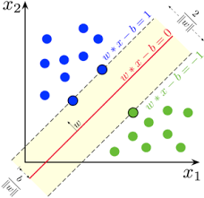
Collaborative-filtering Recommender System using Supervised Learning

Slide 17
Flowchart of KNN based recommender system
KNN identifies learners with similar course-rating patterns and uses their preferences to recommend courses.
Users + Courses + Ratings
User-Course Rating Matrix
Cleaned user-course rating data
User Rating Vectors
Collaborative User Features

Slide 18
Flowchart of NMF based recommender system
Non-Negative Matrix Factorization (NMF) decomposes the user-course rating matrix into two smaller matrices representing user preferences and course characteristics. These latent factors are then combined to predict ratings and identify courses that may be relevant to each learner.
Users + Courses + Ratings
User-Course Rating Matrix
Cleaned user-course rating data
User Rating Vectors
Latent User + Course Factors

Slide 19
Flowchart of Neural Network Embedding based recommender system
Neural Network Collaborative Filtering learns relationships between users and courses using embedding layers. The model learns latent representations of users and courses and uses them to predict the rating a learner may give to a course.
Users + Courses + Ratings
Encode Users and Courses
Cleaned user-course rating data
User + Course Embeddings
Learned Latent Representations

Slide 20
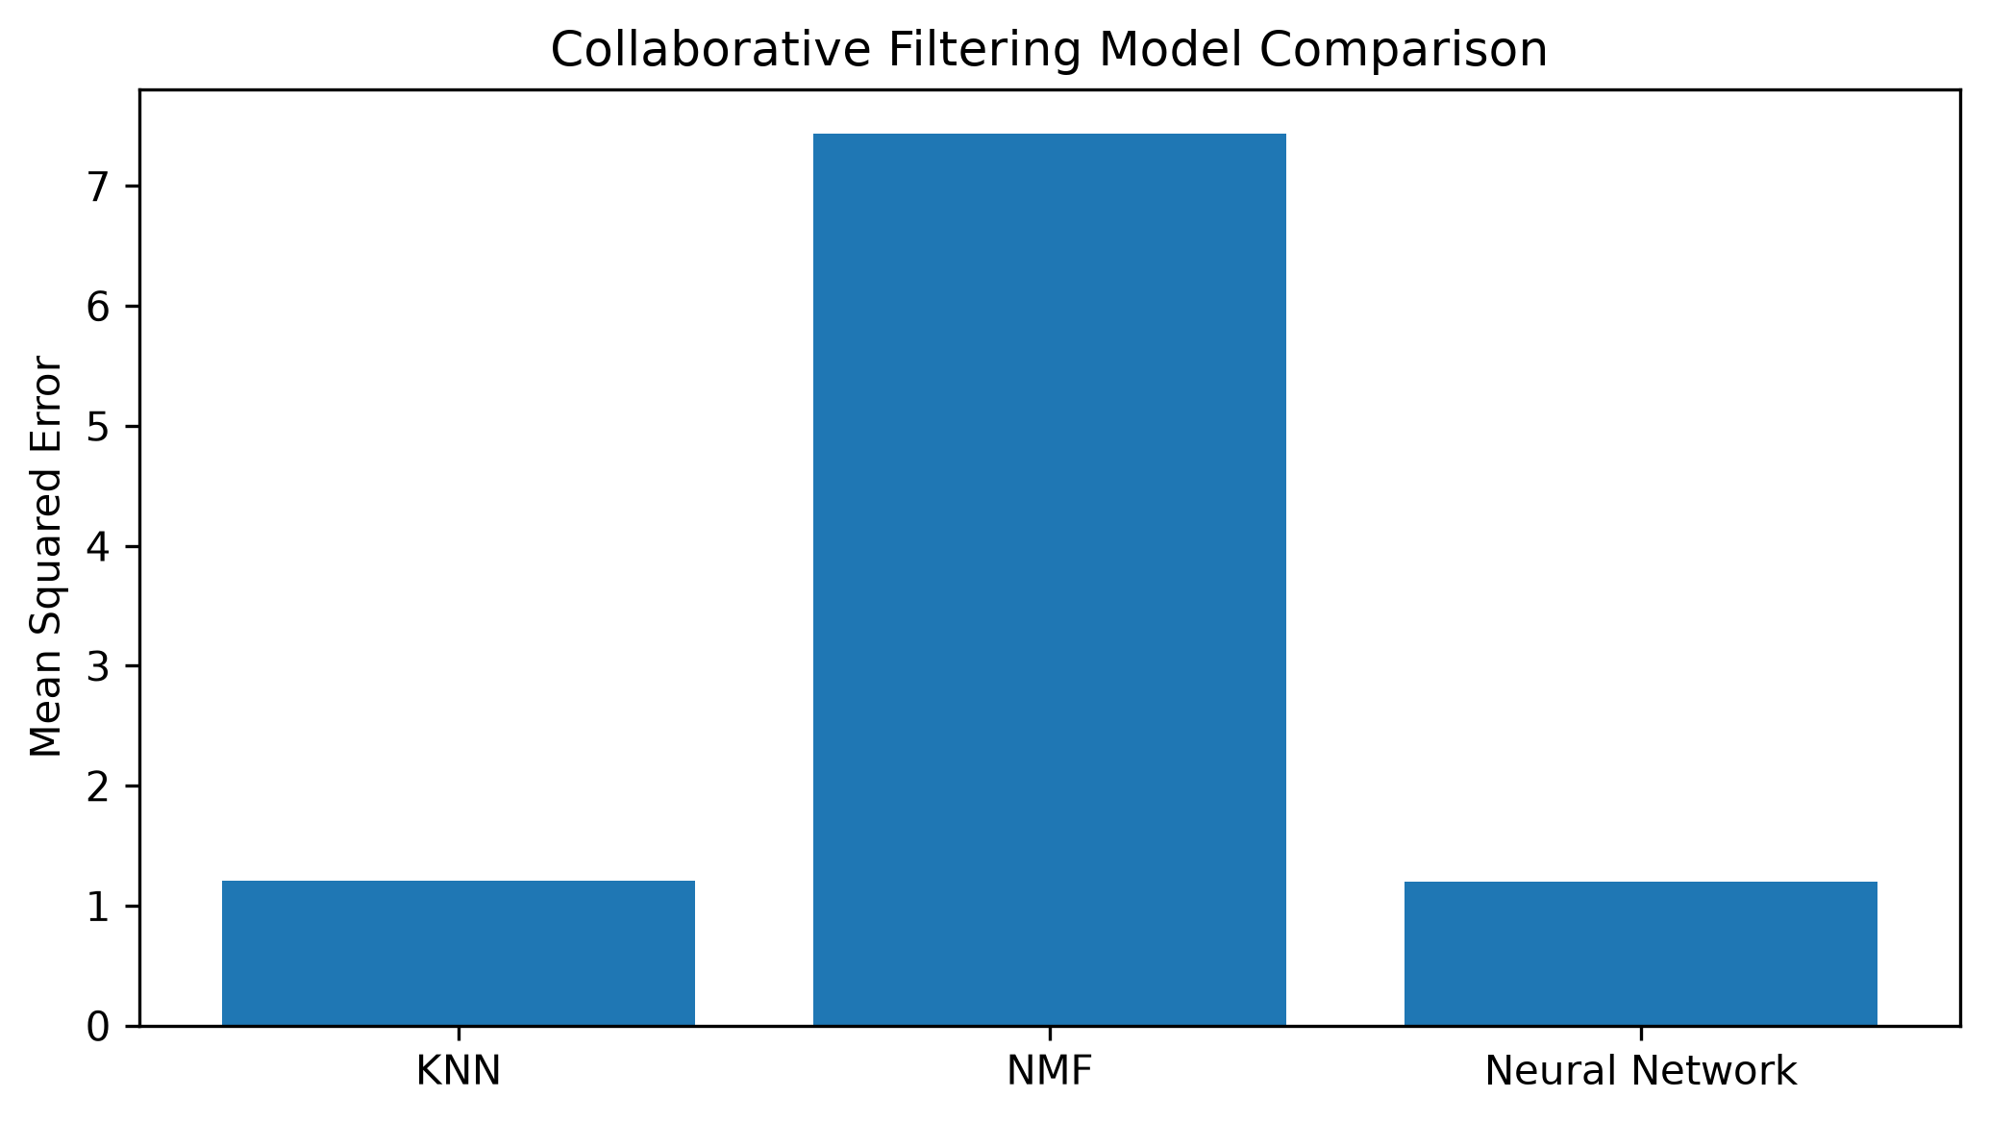
Compare the performance of collaborative-filtering models
Mean Squared Error (MSE) is used to compare the prediction accuracy of the collaborative-filtering models. A lower MSE indicates that the predicted ratings are closer to the actual ratings.
The comparison helps identify which collaborative-filtering approach provides the most accurate rating predictions on the evaluated sample.

Slide 21
Conclusions
The project developed and compared multiple machine learning approaches for personalized online course recommendation.
Content-based methods can recommend courses using course content and genre information.
Collaborative filtering can use learner-course interactions to identify relevant recommendations.
KNN, NMF, and Neural Networks provide different approaches to learning learner preferences.
A hybrid recommendation strategy can combine content-based and collaborative signals for better personalization.

Slide 22
Appendix
Dataset
Course genre data
Processed course data
User-course ratings
Machine Learning Methods
TF-IDF & Cosine Similarity
K-Means & PCA
KNN & NMF
Neural Network
MSE comparison
Recommendation diversity
Evaluation
Catalog coverage
Implementation
Python
Scikit-learn
TensorFlow / Keras

